Slide 1

MICE Product for Oman – II
Travel Period: October to April

Slide 2
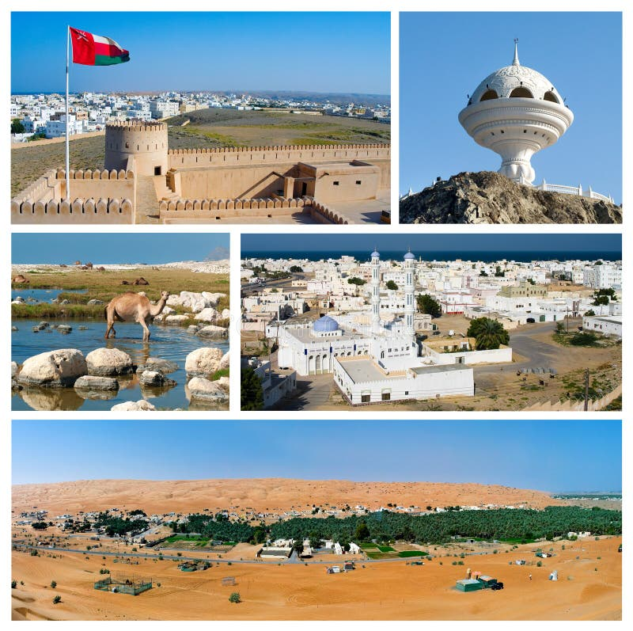
OMAN
Oman, a land of captivating contrasts, beckons with its rich history, breathtaking landscapes, and warm Arabian hospitality. Nestled on the southeastern coast of the Arabian Peninsula, this enchanting country offers a unique blend of ancient traditions and modern progress.

Slide 3

Itinerary Overview

Slide 4
ITINERARY OVERVIEW
Day 1 | Arrival in Muscat
 | Arrive at Muscat international Airport. Meet & greet by our representative
 | Transfer to Hotel
 | Sunset Dhow Cruise (Depends on flight time)
 | Dinner in Bait Al Yasmine
Day 2 | City Orientation of Muscat
 | Breakfast at the Hotel
 | Visit the Sultan Qaboos Grand Mosque
 | Explore the National Museum
 | Photo stop at Al Alam Palace, flanked by Mirani and Jalali Forts
 | Drive along the Corniche and stop at Muttrah Souk
 | Lunch at a local restaurant
 | Return and Dinner at the hotel

Slide 5
ITINERARY OVERVIEW
Day 3 | Drive to Nizwa with en route stops
 | Breakfast at the hotel
 | Visit Jabreen Castle with its ornate stucco & ceilings
 | Continue to Bahla Fort (UNESCO site) for a quick photo stop.
 | Lunch at a local restaurant
 | Arrival in Nizwa and check in and dinner at your hotel
Day 4 | Drive to Jebel Akhdar
 | Breakfast at the Hotel
 | Visit Nizwa Fort & traditional souk
 | Lunch at a local restaurant
 | Continue your drive towards Jebel Akhdar
 | Check-In and dinner at the Hotel

Slide 6
ITINERARY OVERVIEW
Day 5 | Drive to Wahiba Sands
 | Breakfast at the hotel
 | Start your drive towards Wahiba Sands
 | Visit Oman Across Ages Museum on the way.
 | Lunch at a local restaurant
 | Drive to Wahiba Sands and enjoy a 4x4 desert safari
 | Watch sunset over sand dunes
 | Check-in at your camp post reaching and Farewell dinner at the camp

Slide 7
ITINERARY OVERVIEW
Day 6 | Transfer to Muscat & Departure
 | Breakfast at the camp
 | Visit Wadi Bani Khalid for relaxation and swimming (optional)
 | Lunch at a local restaurant
 | Transfer to Muscat Airport for your onward flight

Slide 8
Day 1 Arrival in Muscat

Slide 9
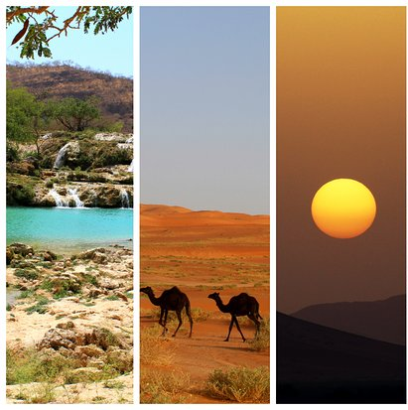
MUSCAT
Oman, a land of captivating contrasts, beckons with its rich history, breathtaking landscapes, and warm Arabian hospitality. Nestled on the southeastern coast of the Arabian Peninsula, this enchanting country offers a unique blend of ancient traditions and modern progress.

Slide 10
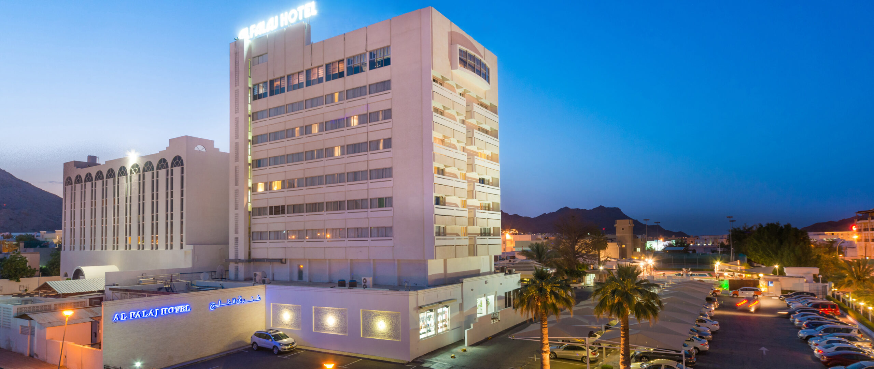

Al-Falaj Hotel, Muscat

Slide 11
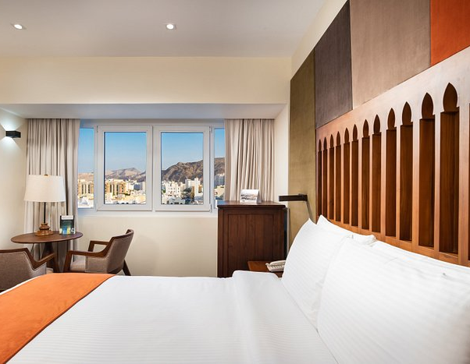
The Al Falaj Hotel in Muscat offers 140 rooms and suites
The size of a deluxe room is approximately 30-35 square meters.

Slide 12
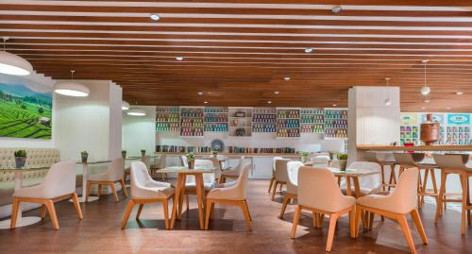
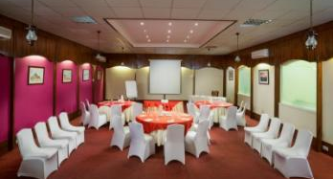
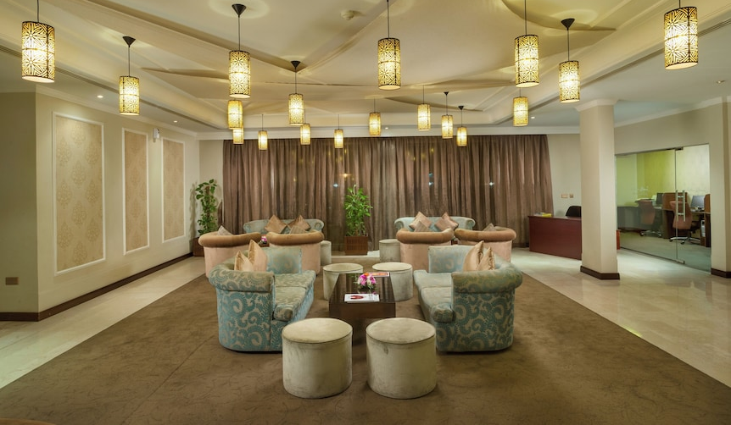
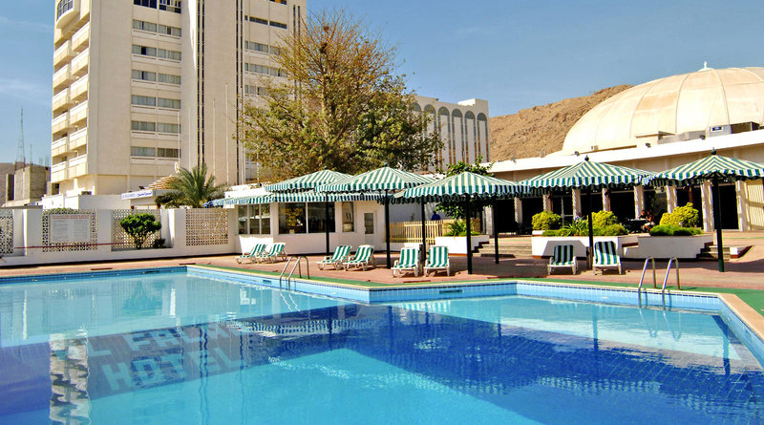

Slide 13
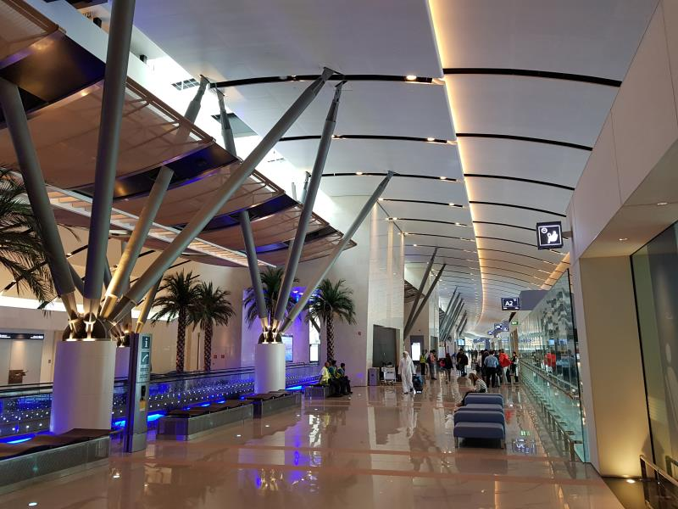
Arrive at Muscat international Airport. Meet & greet by our representative Transfer to Hotel

Slide 14
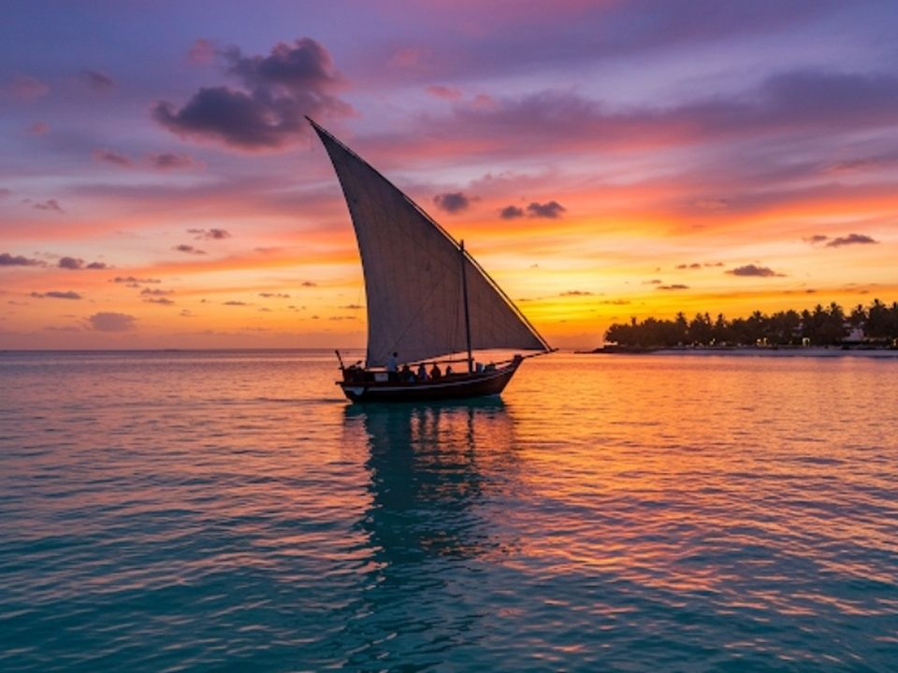
Sunset Dhow cruise
A sunset dhow cruise is a magical experience. As the golden sun dips below the horizon, the sky bursts into vibrant hues of orange, pink, and purple. The traditional wooden dhow glides smoothly over calm waters, offering breathtaking views. The soothing breeze and serene atmosphere create unforgettable memories of peace and beauty.

Slide 15
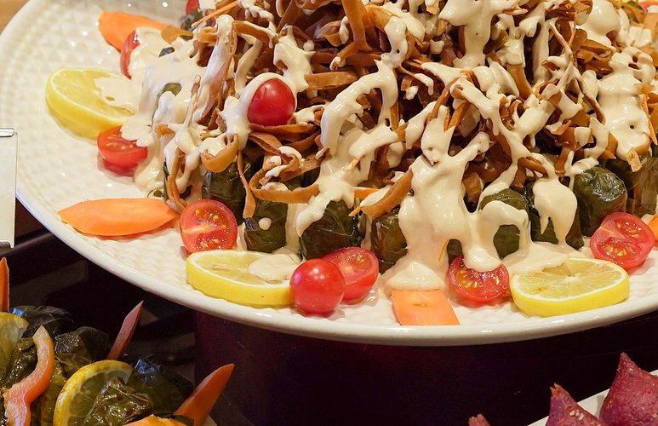
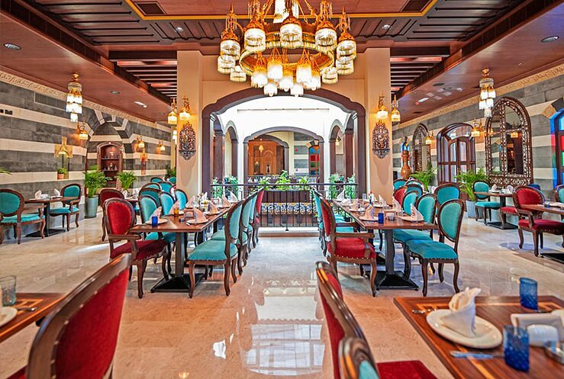
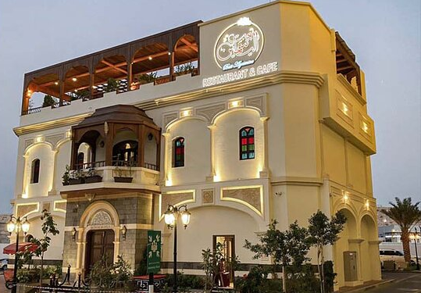
Dinner at Bait Al Yasmine
This charming restaurant offers a delightful blend of Omani and Middle Eastern cuisine in a beautifully decorated setting.
Warm and Rustic
Omani & Middle-Eastern
Al Mouj Marina
Available
60-70

Slide 16
Day 2 City-Orientation of Muscat

Slide 17
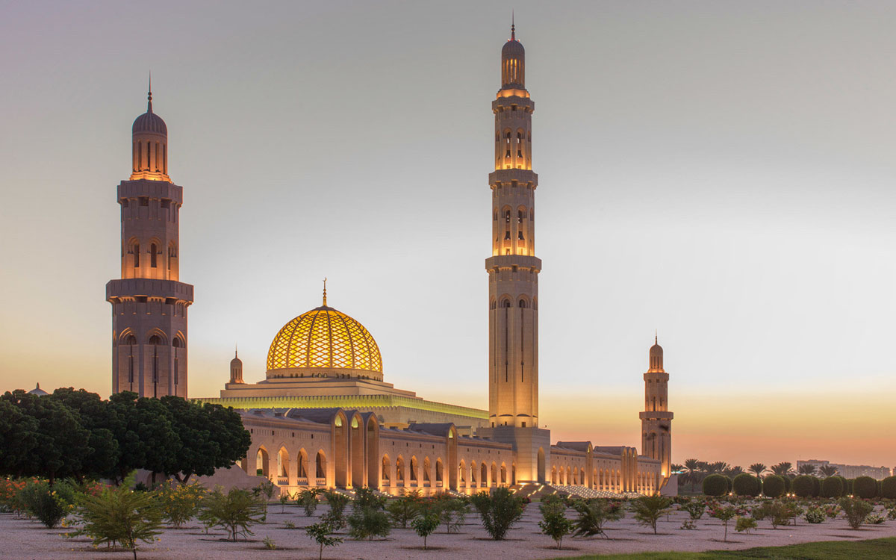
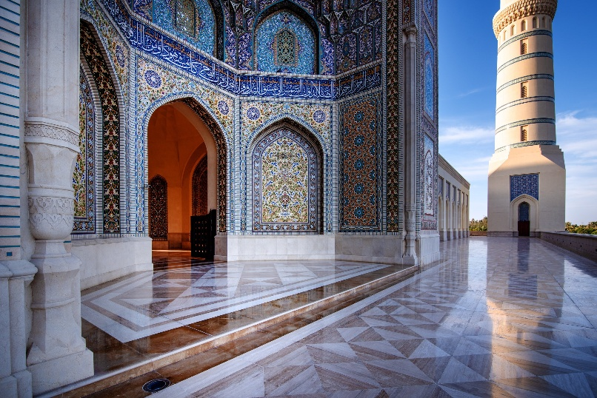
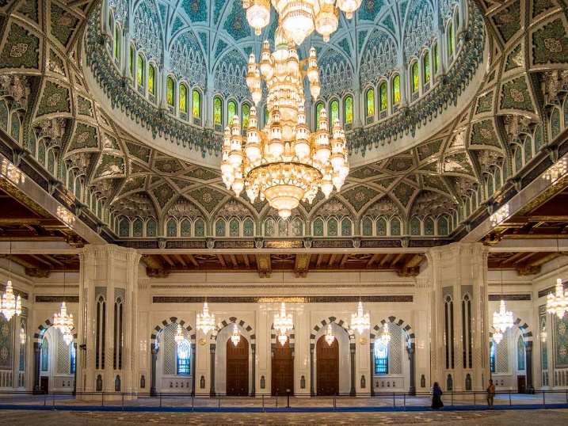
Visit Sultan Qaboos Grand Mosque
The Sultan Qaboos Grand Mosque in Muscat is a stunning architectural masterpiece. With its towering minarets, intricate Islamic designs, and the world’s second-largest handwoven carpet, it reflects Oman’s rich heritage. The serene ambiance, majestic chandeliers, and sprawling marble courtyards make it a must-visit spiritual and cultural landmark.

Slide 18
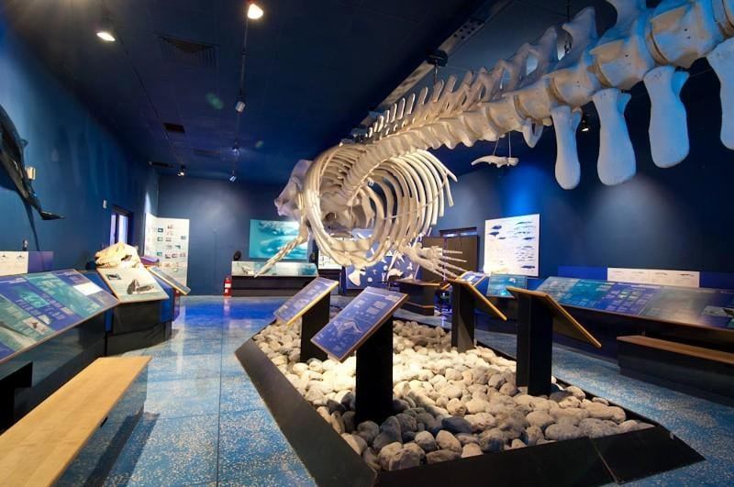
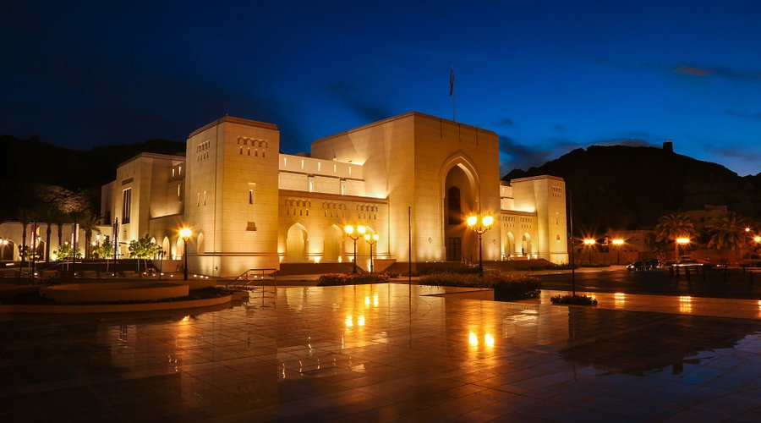
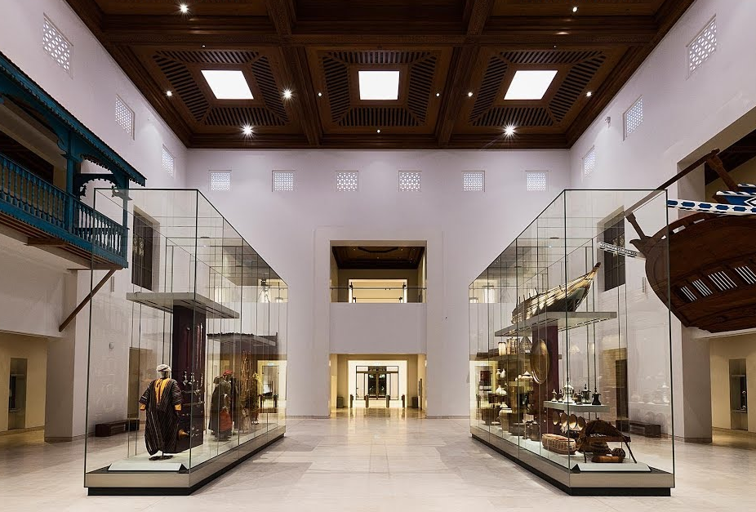
Explore the National Museum
The National Museum of Muscat showcases Oman’s rich heritage through artifacts, manuscripts, and interactive exhibits. Its modern design blends tradition with innovation, featuring ancient weaponry, traditional costumes, and maritime history. A cultural gem, it offers deep insights into Oman’s past.

Slide 19
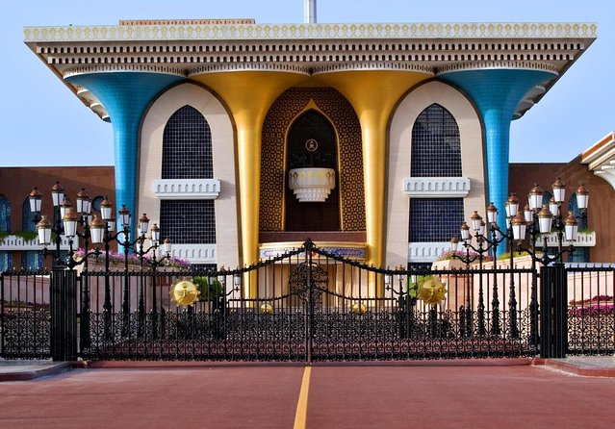
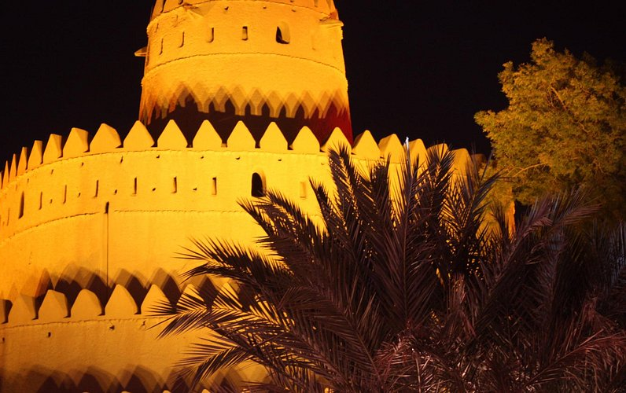
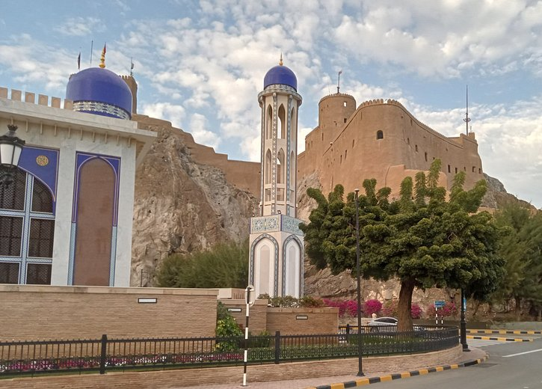
Photo stop at Al Alam Palace, flanked by Mirani and Jalali Forts

Slide 20
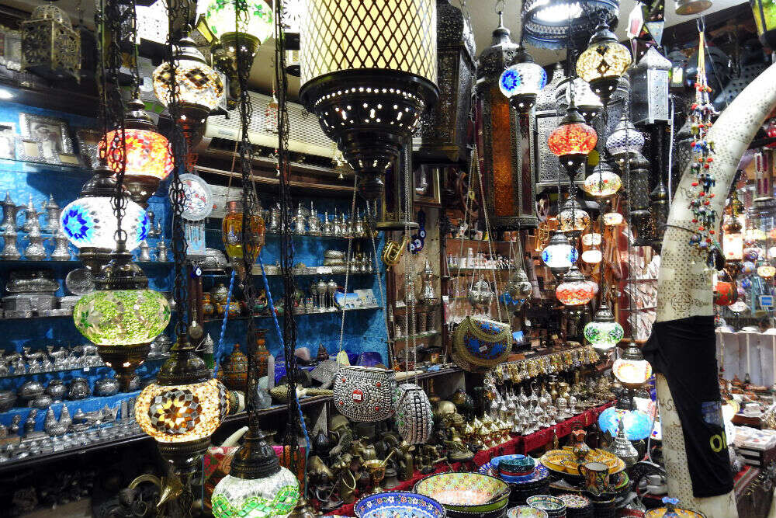
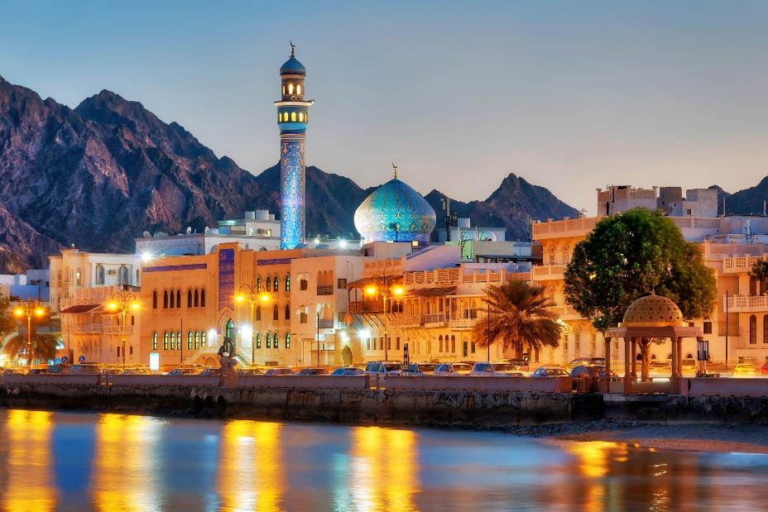
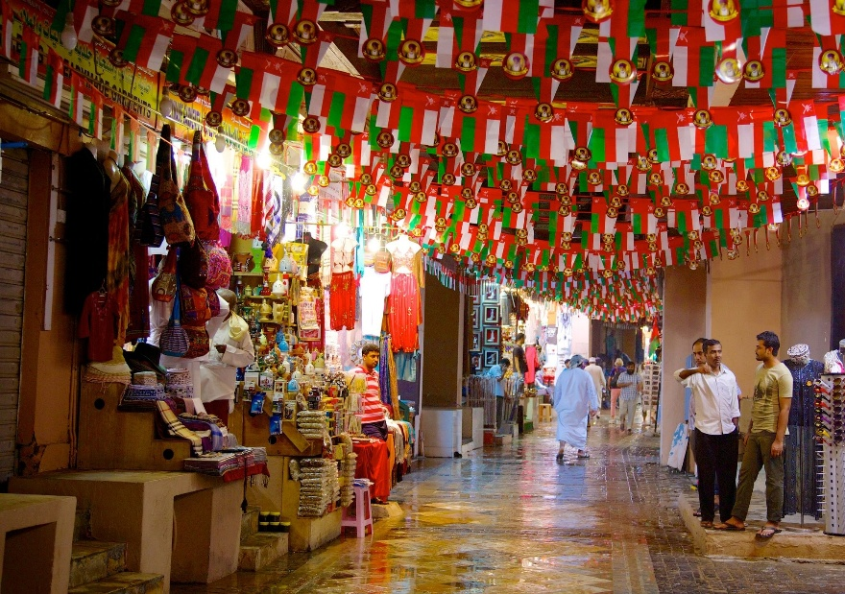
Drive along the Corniche and stop at Muttrah Souk followed by Lunch at a Local Restaurant

Slide 21
Day 3 Nizwa

Slide 22
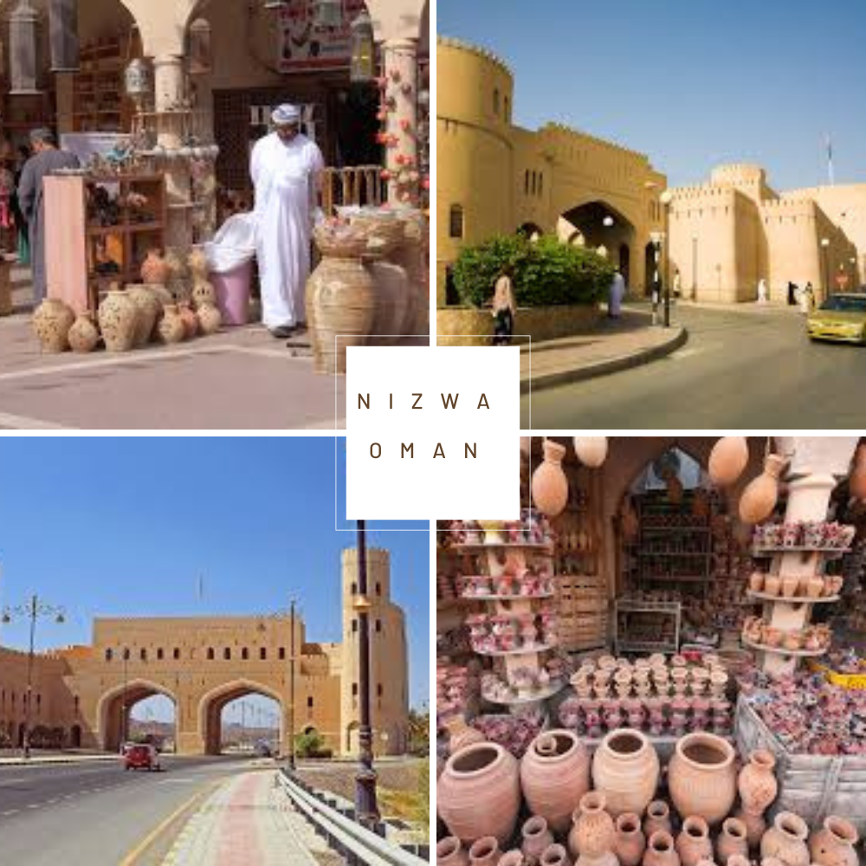
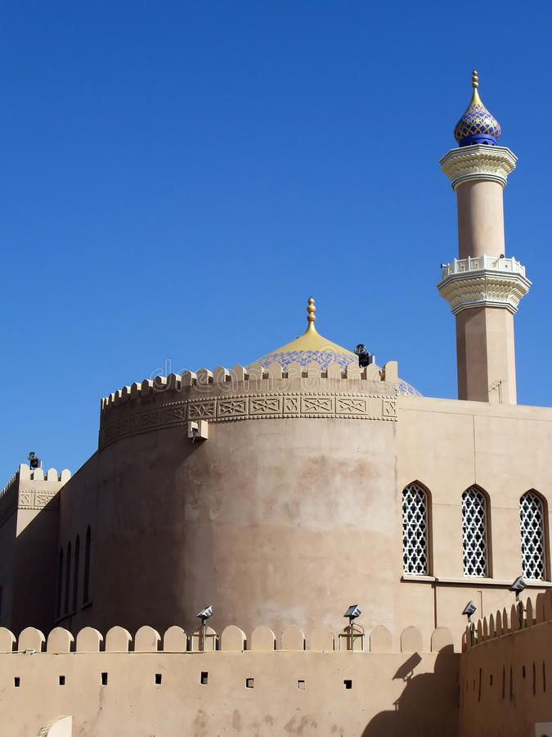
NIZWA
Nizwa, Oman’s cultural heart, is famous for its majestic 17th-century fort and bustling souq. Surrounded by mountains and date palms, it offers a glimpse into Oman’s rich heritage. Visitors explore traditional crafts, watch goat auctions, and climb the fort’s towering walls for breathtaking views. A must-visit for history and adventure lovers!

Slide 23
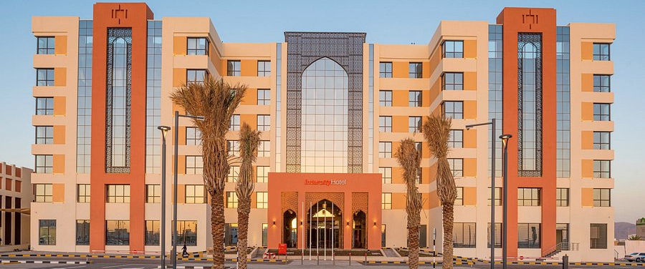
InterCity Hotel, Nizwa

Slide 24
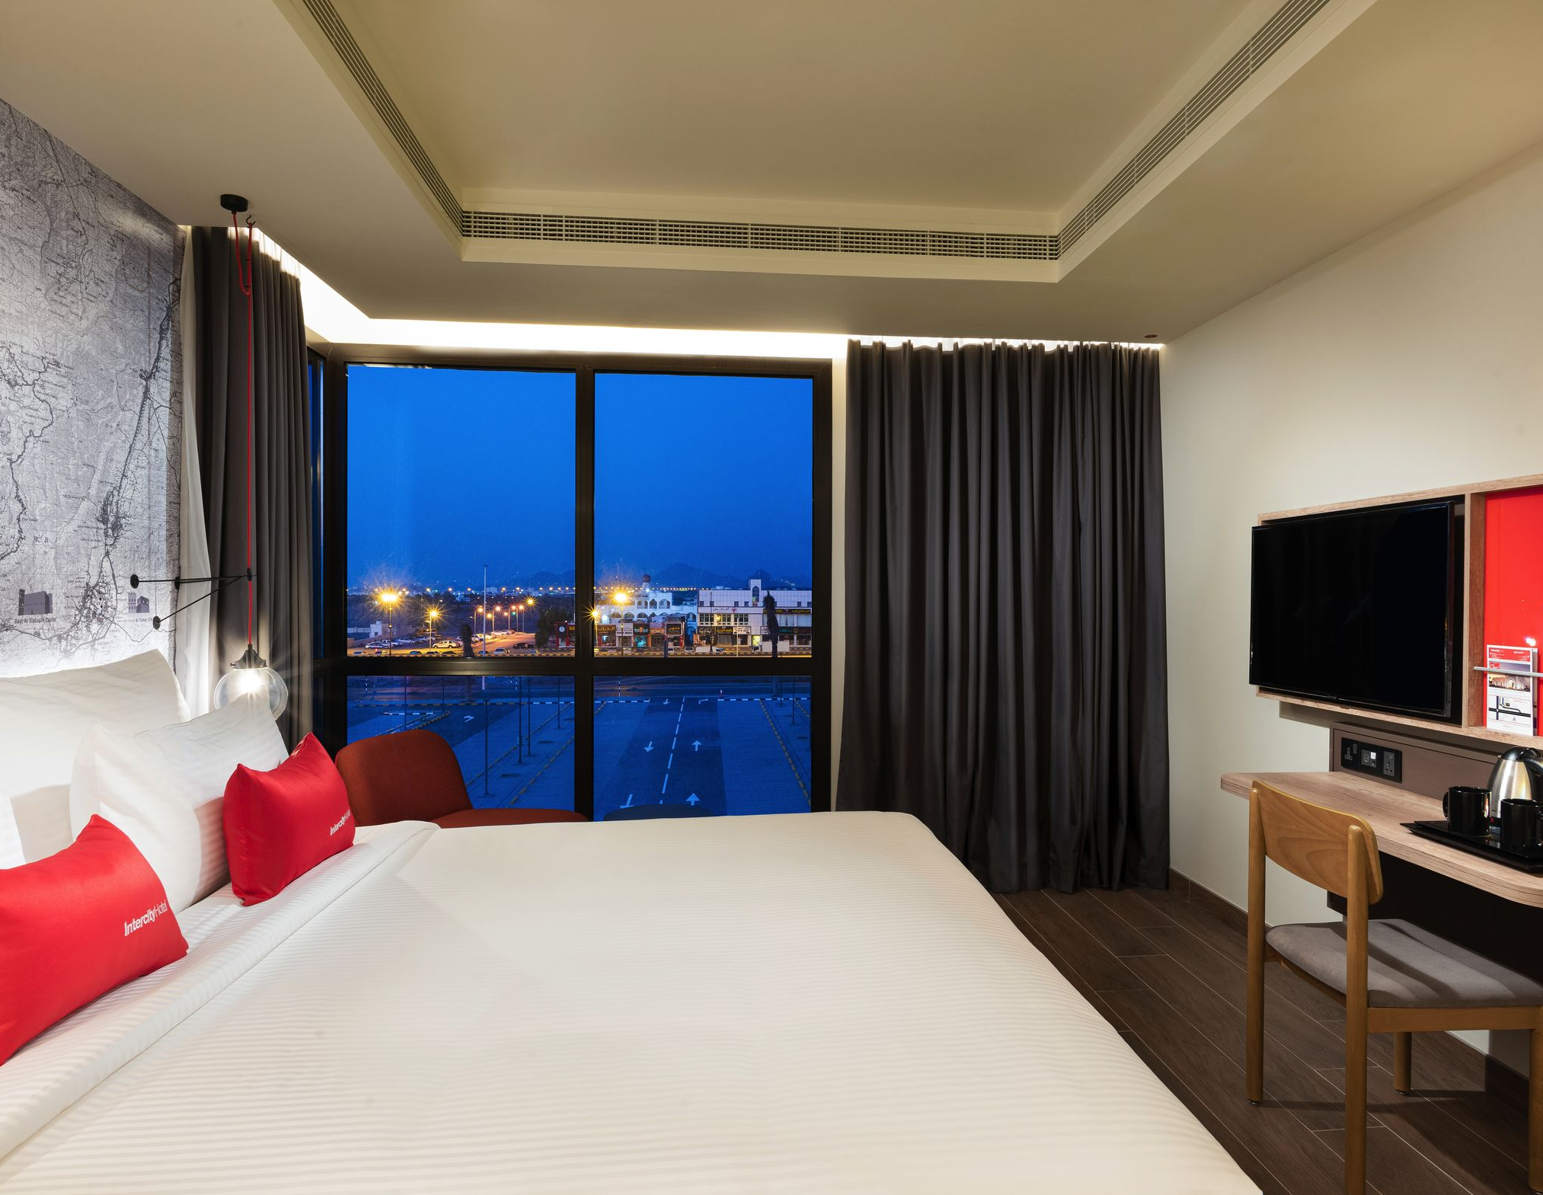
The Intercity Hotel, Nizwa offers 104 rooms.
The size of a room is approximately 28-30 square meters.

Slide 25
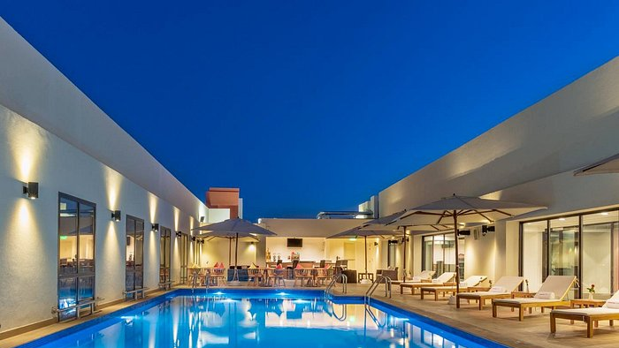
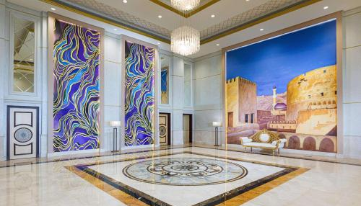
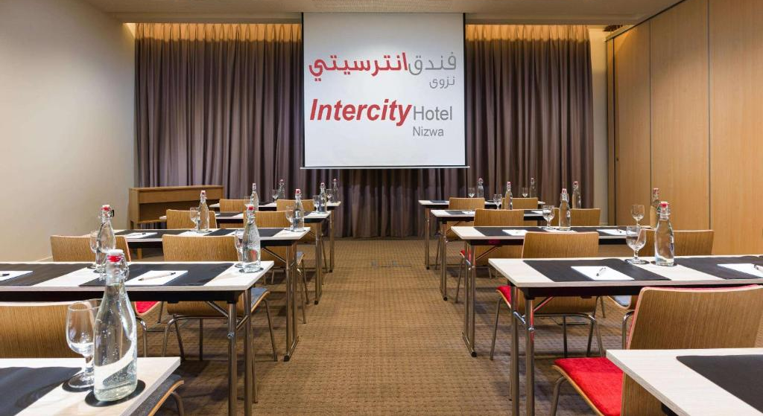
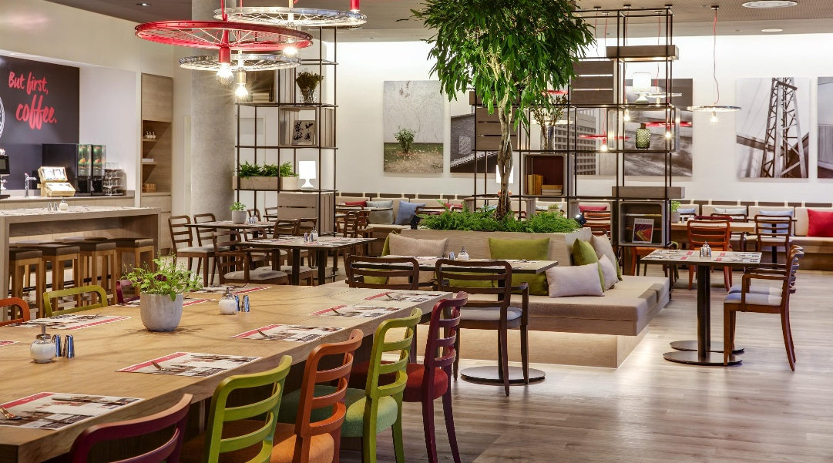

Slide 26
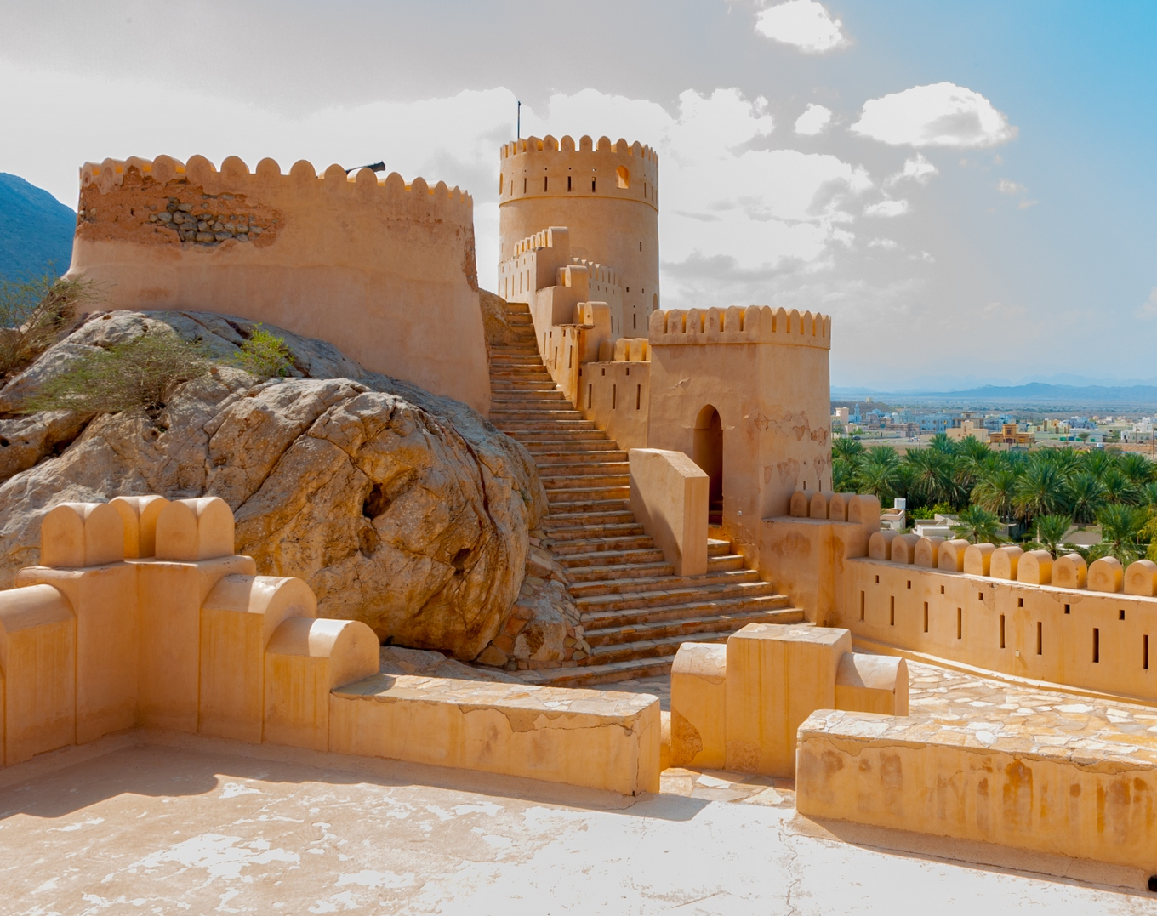
Visit Jabreen Castle with its ornate stucco & ceilings
Jabreen Castle, a 17th-century masterpiece, showcases Omani architecture at its finest. Built by Imam Bil’arab bin Sultan, its intricate carvings, grand halls, and hidden passages reflect Islamic artistry. Once a seat of learning and governance, it now stands as a historic gem, offering visitors a glimpse into Oman’s rich cultural heritage.

Slide 27
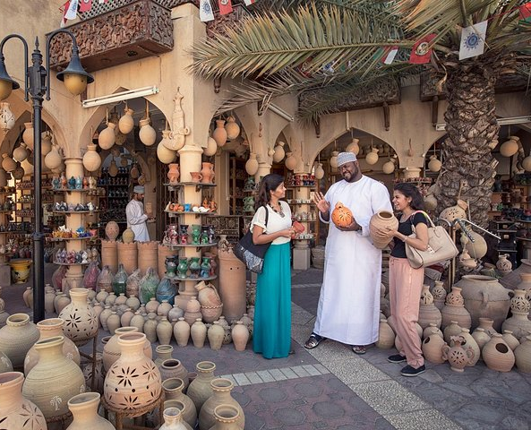
Continue to Bahla Fort (UNESCO site) famous for its pottery for a quick photo stop
Bahla Fort, a UNESCO World Heritage Site, is a stunning example of Omani architecture. Nearby, traditional pottery thrives, crafted using ancient techniques passed down for generations. The earthy, hand-shaped clay pots reflect Bahla’s rich heritage, blending history and artistry in a timeless craft unique to this historic oasis town.

Slide 28
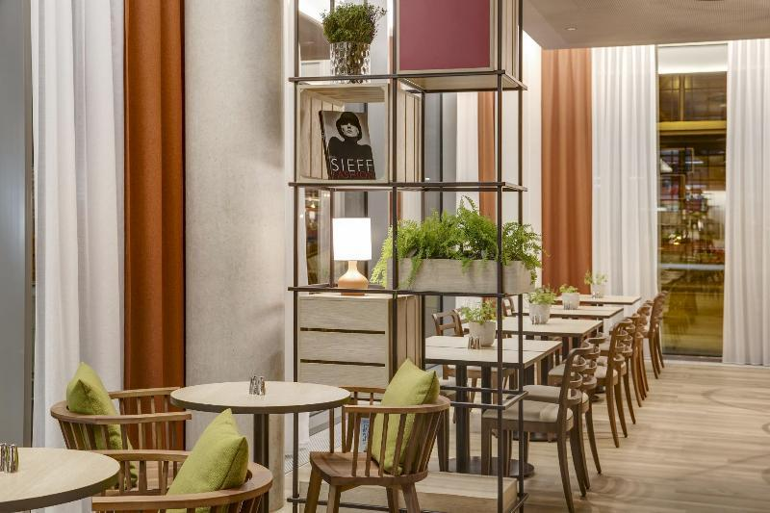
Lunch at a Local Restaurant followed by Check-in at the hotel in Nizwa

Slide 29
Day 4 Jebel Akhdar

Slide 30
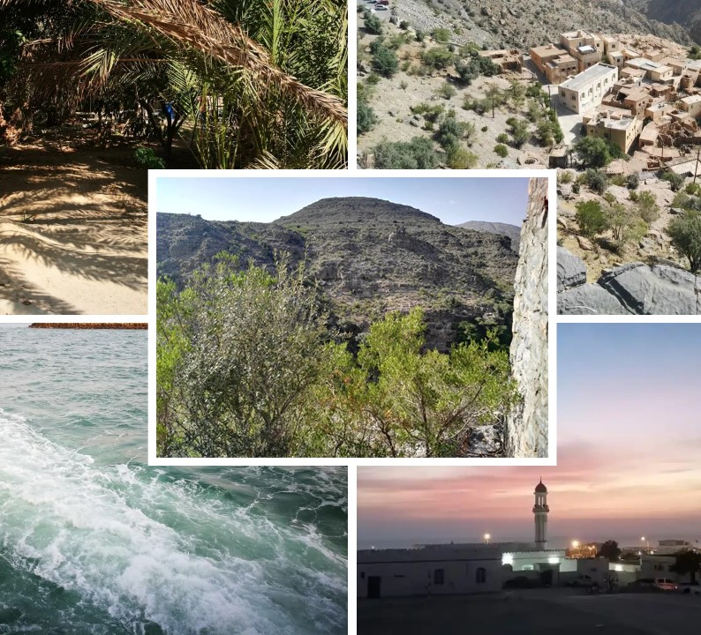
JEBEL AKHDAR
Jebel Akhdar, part of the Al Hajar range, is a breathtaking oasis known for its cool climate, terraced farms, and fragrant rose gardens. Famous for pomegranates and walnuts, it offers stunning hikes, dramatic cliffs, and traditional villages. A must-visit for nature lovers and adventure seekers exploring Oman’s highlands.

Slide 31
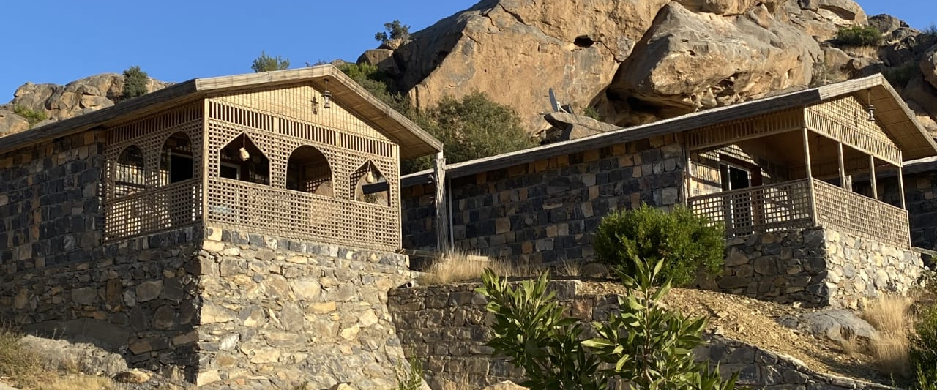
Sama Heights Resort, Jebel Akhdar

Slide 32
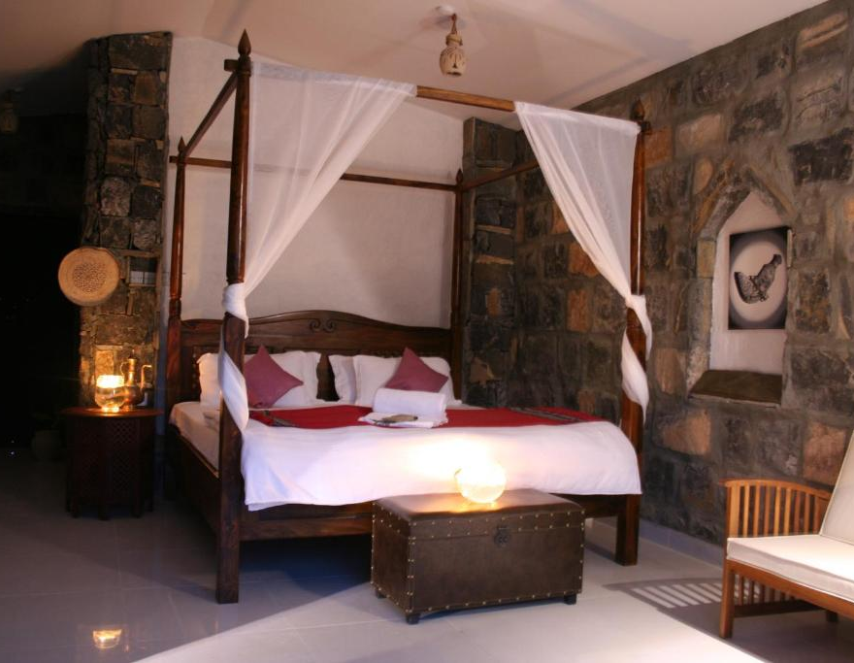
The Sama Heights Resort, Jebel Akhdar offers
18 luxurious villas
The villas range in size from 85 sqm (1-bedroom) to 160 sqm (2-bedroom)

Slide 33
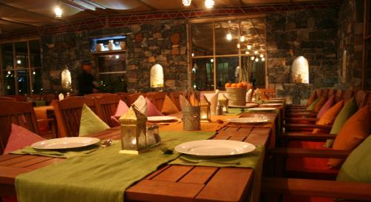
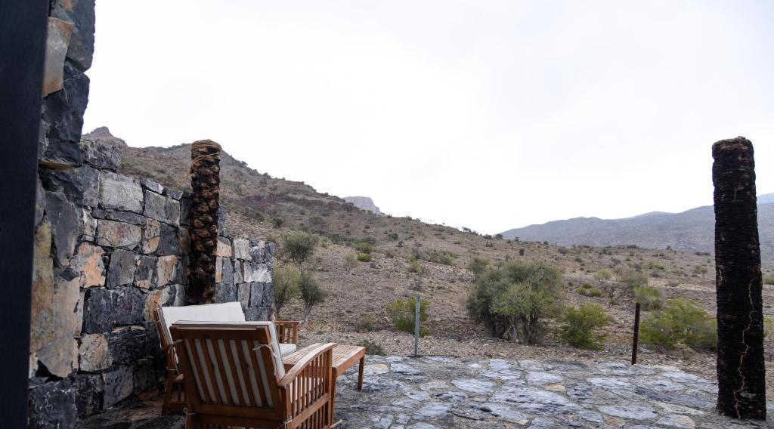
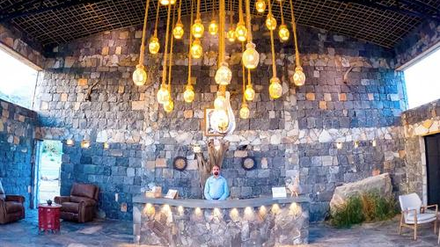
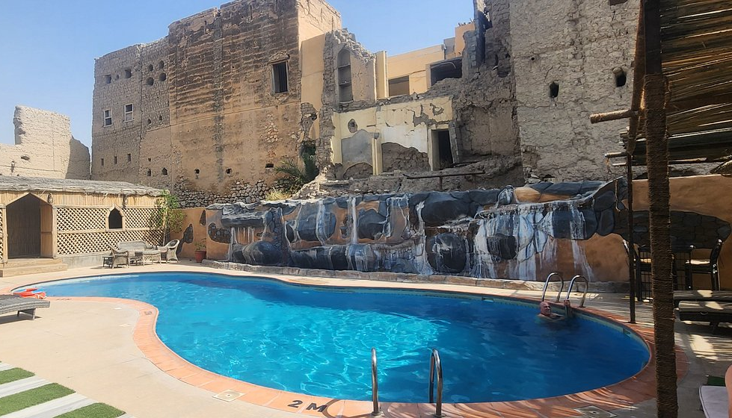

Slide 34
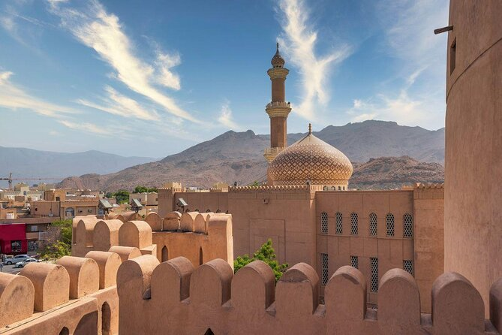
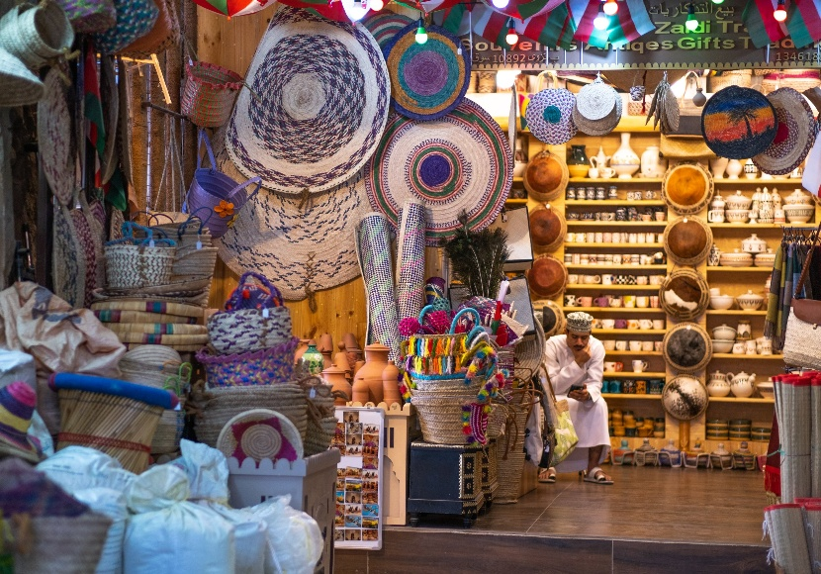
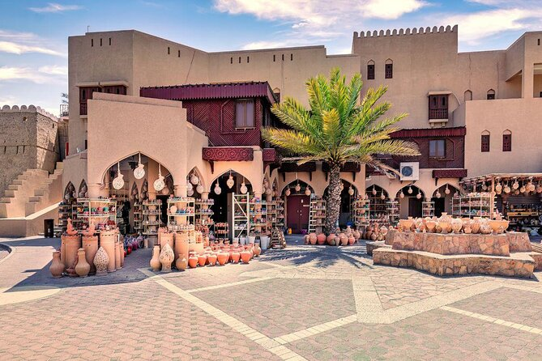
Visit Nizwa Fort & traditional souk

Slide 35
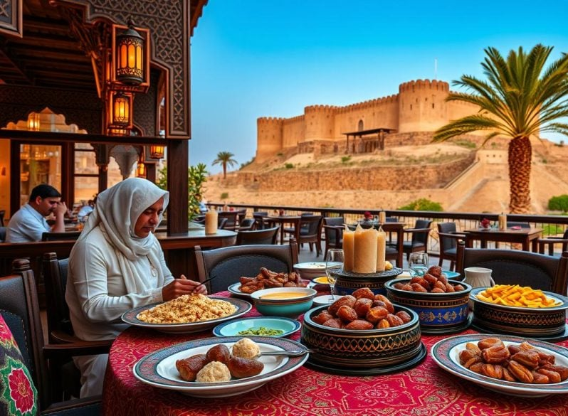
Lunch at a local restaurant Continue your drive towards Jebel Akhdar followed by Check-in at the Hotel

Slide 36
Day 5 Wahiba Sands

Slide 37
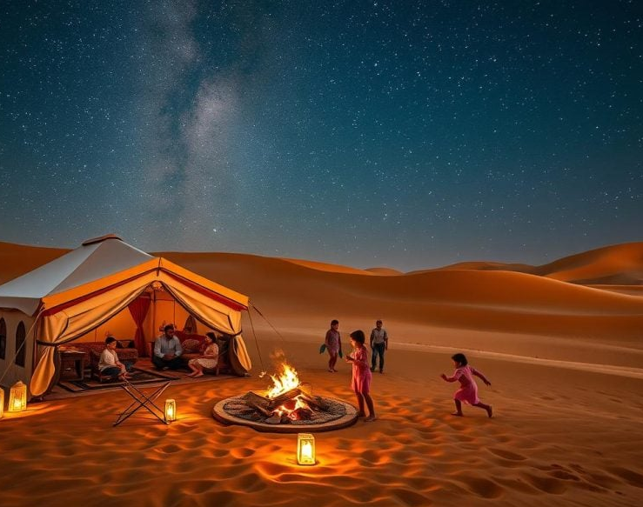
WAHIBA SANDS
Wahiba Sands is a mesmerizing desert in Oman, with golden dunes stretching endlessly. Visitors enjoy thrilling dune bashing, camel rides, and stunning sunsets. Bedouin camps offer cultural experiences under starry skies. The ever-shifting sands create a magical, tranquil escape, perfect for adventure and reflection in Oman’s breathtaking wilderness.

Slide 38
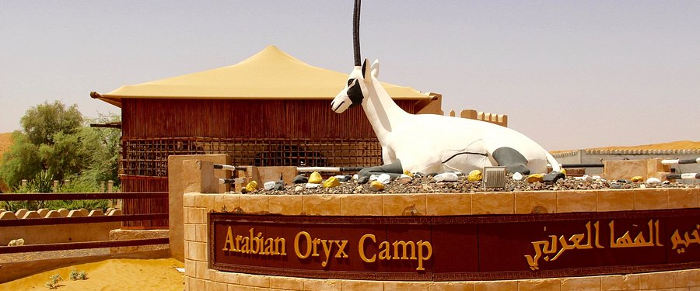
Arabian Oryx Camp, Wahiba Sands

Slide 39
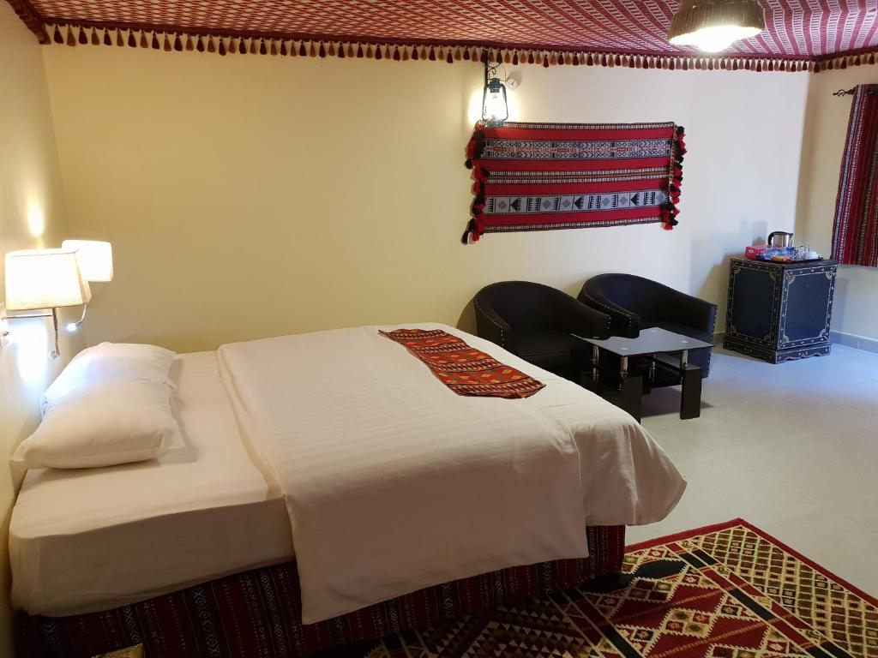
The camp features 10 traditional Bedouin-style tents, each approximately 25–30 sqm in size.

Slide 40





Slide 41

Breakfast at the Hotel and then start your Drive to Wahiba Sands

Slide 42



Visit Oman Across Ages Museum on the way followed by Lunch at a Local restaurant

Slide 43



Drive to Wahiba Sands and enjoy a 4x4 desert safari Optional desert activities (camel ride / quad bike)

Slide 44

Watch sunset over Sand Dunes followed by Check-in at your camp and Farewell Dinner

Slide 45
Day 6 Departure

Slide 46



Visit Wadi Bani Khalid for relaxation and swimming (optional)

Slide 47

Lunch at a Local restaurant and Drive to Muscat Airport

Slide 48
THANK YOU!

